Slide 1

Department of Electrical Engineering
Senior Design Project ELEC 499
Qatar University First Solar Car to Compete in the World Solar Challenge: Design of Energy Management System
Mariam El-Menshawy 201105930
Mena El-Menshawy 201203675
Main Supervisor: Dr. Ahmed Massoud
Co- Supervisor: Prof. Adel Gastli

Slide 2
Outline:
Background & Problem Definition
Objectives
Main Electrical Components of Solar Car
Practical Results
Conclusion
Future Work

Slide 3
Outline:
Background & Problem Definition
Objectives
Main Electrical Components of Solar Car
Practical Results
Conclusion
Future Work

Slide 4

Background & Problem Definition:
Electric vehicles versus Conventional vehicles.

Slide 5
Outline:
Background & Problem Definition
Objectives
Main Electrical Components of Solar Car
Practical Results
Conclusion
Future Work

Slide 6
Objectives:
Maximize the system through the effective usage of energy management that includes PV and energy storage systems technology.
System architecture.

Slide 7
Outline:
Background & Problem Definition
Objectives
Main Electrical Components of Solar Car
Practical Results
Conclusion
Future Work

Slide 8
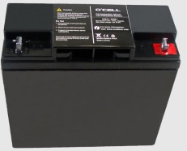
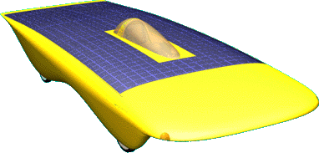
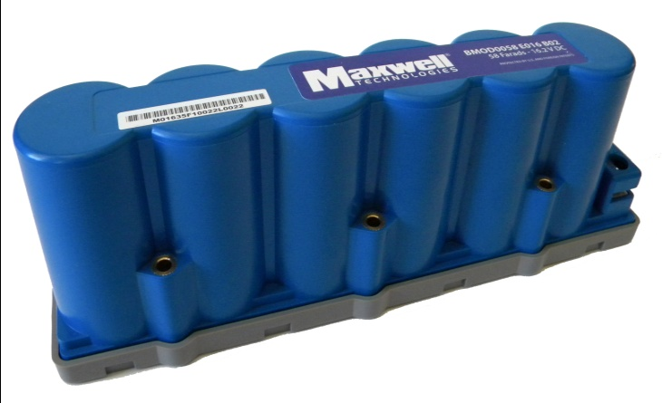
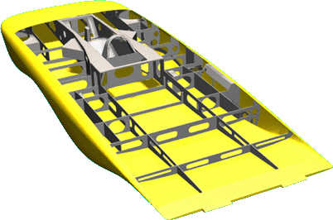
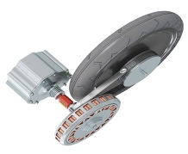
Main Electrical Components of Solar Car:
Solar Array
Battery
Ultra-capacitors
Motor

Slide 9

PV Modeling:
Solar Insolation Effect
P-V output characteristics with different values of solar Insolation at constant Temperature level of 25˚C.

Slide 10

PV Modeling:
Operating Temperature Effect
P-V output characteristics with different values of operating Temperature at constant Insolation level of 1 kW/m².

Slide 11
Maximum Power Point Tracking:
DC/DC Converter
Battery
PV Array
Voltage & Current Measurement
PWM Generator
MPPT Algorithm (P&O) + Duty Cycle Adjustment
PV conversion system.

Slide 12
Perturb & Observe Technique:
P_{PV}
(W)
Region A
P_{max}
Region B
A₂
B₁
P₁
A₁
P₂
B₂
V₁
V₂
V_{PV} (V)

Slide 13
Energy Storage System:
Batteries:
There are four battery choices which are: Lithium ion (Li-Ion), Lithium polymer (Li-Po), Nickel metal hydride (Ni-MH), and Lead acid (Pb-Acid).
WSC battery weight limitations.
Li-ion | Li-Polymer | LiFePO4 | Ni-MH | Pb-Acid
20 kg | 20 kg | 40 kg | 70 kg | 125 kg

Slide 14
Batteries:
Lithium ion (Li-ion) battery is the ideal choice to be used for the solar car because of the following reasons:
High energy density
Fast & efficient charging
Relatively low self-discharge
Extended cycle life
Size & Weight advantages

Slide 15
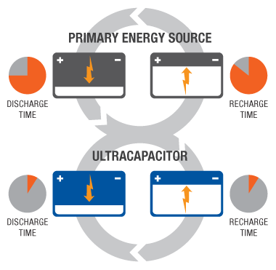
Energy Storage System:

Slide 16
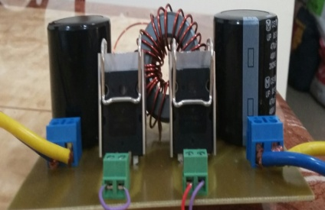
Energy Management:
Unidirectional Buck-Boost Converter
I_{load}
I_{PV}
PV Array
V_{bus}
Bidirectional Buck-Boost Converter
I_{B}
Battery
Bidirectional Buck-Boost Converter
I_{C}
Ultra-capacitor

Slide 17
Scenarios:
Closed loop scheme.
Open loop scheme.

Slide 18
Outline:
Background & Problem Definition
Objectives
Main Electrical Components of Solar Car
Practical Results
Conclusion
Future Work

Slide 19
Practical Results:
System parameters.
 | System Parameters
PV Panel | Open Circuit Voltage V_{oc} Short Circuit Current I_{SC} Maximum Power P_{mpp} | 40 V 4 A 120 W
Battery | Battery Type Nominal Voltage V_{B} Rated Capacity | Lead-Acid 12 V 100 Ah
Ultra-capacitors | Voltage V_{UC} Capacitance | 16.2 V 58 F
Resistive Load | Power | 3.3 kW

Slide 20
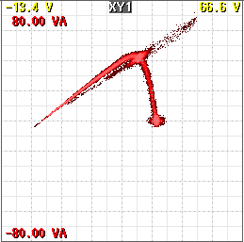
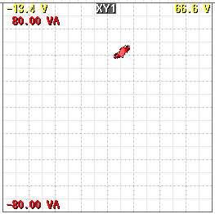
Maximum Power Point Tracking:
(a) (b)
P_{PV}
(W)
P_{PV}
(W)
V_{PV} (V)
V_{PV} (V)
MPPT results at 10 W/div and 10 V/div with a perturb size of 0.0000001:
(a) PV curve at variable duty cycle; (b) Maximum Power Point.

Slide 21
Maximum Power Point Tracking:
MPPT results with a perturb size of 0.01
5 s/div
4 W/div 20 V/div 200 mA/div
MPPT results with a perturb size of 0.0000001
5 s/div
4 W/div 20 V/div 200 mA/div

Slide 22
Charging Case:
PV charging the battery and supplying the load
Energy Management Cases:

Slide 23
D = 0.27
Efficiency = 67 %
P_{loss} = 17.44 W
V_{pvi} = 32.11 V
I_{pvi} = 1.66 A
P_{pvi} = 53.23 W
P
V_{pvo} = 11.93V
I_{pvo} = 2.99 A
P_{pvo} = 35.79 W
PV Array
DC/DC
Converter
V_{B} = 12.06 V
I_{B} = 1.75 A
P_{B} = 21.12 W
P
Battery
Total P_{loss} = 22.75 W
DC Bus
V_{loado} = 10.25 V
I_{loado} = 1.01 A
P_{loado} = 10.40 W
P
V_{loadi} = 11.98 V
I_{loadi} = 1.31 A
P_{loadi} = 15.71 W
R = 10 Ω
R Load
DC/DC
Converter
D = 0.5
Efficiency = 66 %
P_{loss} = 5.31 W
Ultra-capacitor
DC/DC
Converter

Slide 24
Losses of the IGBT module.

Slide 25
Discharging Case:
PV and battery supplying the load
Energy Management Cases:

Slide 26
D = 0.27
Efficiency = 65.4 %
P_{loss} =21.27 W
V_{pvi} = 30.89 V
I_{pvi} = 1.97 A
P_{pvi} = 60.98 W
P
V_{pvo} = 11.46 V
I_{pvo} = 3.48 A
P_{pvo} = 39.71 W
PV Array
DC/DC
Converter
V_{B} = 11.39 V
I_{B} = 3.51 A
P_{B} = 39.98 W
P
Battery
Total P_{loss} = 56.46 W
DC Bus
V_{loado} = 17.87 V
I_{loado} = 2.44 A
P_{loado} = 43.68 W
P
V_{loadi} = 11.13 V
I_{loadi} = 7.09 A
P_{loadi} = 78.63 W
R = 7 Ω
R Load
DC/DC
Converter
D = 0.67
Efficiency = 55.38 %
P_{loss} = 35.19 W
Ultra-capacitor
DC/DC
Converter

Slide 27
Discharging Case:
Battery supplying the load
Energy Management Cases:

Slide 28
V_{pvi} = 40 V
I_{pvi} = 0 A
P_{pvi} = 0 W
P
V_{pvo} = 11.45 V
I_{pvo} = 0 A
P_{pvo} = 0 W
PV Array
DC/DC
Converter
D = 0.23
V_{B} = 11.56 V
I_{B} = 2.44 A
P_{B} = 28.23 W
P
Battery
Total P_{loss} = 10.3 W
DC Bus
V_{loado} = 19.95 V
I_{loado} = 0.96 A
P_{loado} = 19.06 W
P
V_{loadi} = 11.66 V
I_{loadi} = 2.52 A
P_{loadi} = 29.36 W
R = 20 Ω
R Load
DC/DC
Converter
D = 0.67
Efficiency = 64.93 %
P_{loss} = 10.3 W
Ultra-capacitor
DC/DC
Converter

Slide 29
Discharging Case:
Battery charging the ultra-capacitors
Energy Management Cases:

Slide 30
PV Array
DC/DC
Converter
P
Battery
V_{B} = 11.53 V
I_{B} = 3.24 A
P_{B} = 37.29 W
Total P_{loss} = 11.12 W
V_{UCo} = 18.69 V
I_{UCo} = 1.22 A
P_{UCo} = 22.83 W
V_{UCi} = 11.43 V
I_{UCi} = 3.19 A
P_{UCi} = 36.51 W
DC Bus
P
Ultra-capacitors
R = 3 Ω
DC/DC
Converter
V_{UC} = 16.09 V
I_{UC} = 1.24 A
P_{UC} = 19.98 W
D = 0.67
Efficiency = 62.5 %
P_{loss} = 13.68 W

Slide 31
Design Limitations:
Silicon devices instead of Silicon Carbide devices
Low efficiency
Ultra-capacitors closed loop operation
Low voltage DC bus

Slide 32
Outline:
Background & Problem Definition
Objectives
Main Electrical Components of Solar Car
Practical Results
Conclusion
Future Work

Slide 33
Conclusion:
Three different sources are used to transfer power according to the load requirements which are PV modules, battery, and ultra-capacitors.
Fixed perturbation size results in a trade-off between fast response and steady state oscillations.
Low efficiency is due to the fact that:
The converters are designed for high power ratings.
The IGBT’s losses.
Parasitic elements.
Low voltage DC bus.

Slide 34
Outline:
Background & Problem Definition
Objectives
Main Electrical Components of Solar Car
Practical Results
Conclusion
Future Work

Slide 35
Future Work:
Closed loop operation scheme.
Multiport Power Electronic Interface.
Multiport
DC/DC Converter
PV Array
Regulated DC Voltage
Battery
Ultra-capacitors

